Slide 1


AMC ENGINEERING COLLEGE,BENGALURU-83
(Approved by , Permanently Affiliated to
VTU, Belagavi, Accredited by NAAC & NBA)
DEPARTMENT OF ELECTRONICS & COMMUNICATION ENGINEERING
PROJECT ON
CRACK DETECTION AND WATER LEVEL INDICATOR IN DAM
GUIDED BY:
GROUP MEMBERS:
Dr .R.ARUNA
ASSOCIATE PROFESSOR
Dept of ECE
NAVEEN B - 1AM22EC072 PALLAVI S - 1AM22EC084 PRADEEP S N- 1AM22EC086 PRATHIBHA H - 1AM22EC089
1

Slide 2
CONTENT
ABSTRACT
OBJECTIVE
PROBLEM STATEMENT
INTRODUCTION
LITERATURE SURVEY
BLOCK DIAGRAM
IMLEMENTATION
RESULTS
CONCLUSION
REFERENCE
GANTT CHART
PUBLISHED PAPERS
CERTIFICATES
SDG’s
2

Slide 3
ABSTRACT
Dams are critical infrastructures that support water resource management, energy production, and flood control. Ensuring their structural integrity is essential for public safety and operational efficiency. This project presents an integrated system combining crack detection with water level monitoring to provide a comprehensive real-time assessment of dam health.The proposed approach employs high-resolution imaging techniques coupled with advanced digital image processing algorithms to detect and analyze micro-cracks and other structural anomalies. Simultaneously, a network of robust water level sensors continuously monitors reservoir levels to identify unusual fluctuations that may indicate operational risks.

Slide 4
OBJECTIVE
Ensure Dam Safety – To prevent structural failures by detecting cracks and
monitoring water levels.
Early Fault Detection – To identify cracks and anomalies before they become
critical
Prevent Flooding and Water Shortages – To maintain optimal water levels to avoid disasters.
Enhance Decision-Making – To provide accurate data for engineers and
authorities to take preventive actions.

Slide 5
PROBLEM STATEMENT
Structural Integrity Concerns:
Dams are critical infrastructures whose safety relies on their structural soundness. Small cracks or fissures, if undetected, can evolve into severe structural failures.
Delayed Detection of Cracks:
Traditional inspection methods often miss early-stage micro-cracks. This delay in detection can lead to a lack of timely maintenance and eventual catastrophic outcomes.
Integration Gap:
There exists a challenge in combining two essential monitoring systems— crack detection and water level indication—into a single, real-time, and reliable solution.
Data Analysis and Real-Time Alerts:
Developing a system that not only collects data but also analyzes it in real- time to generate actionable alerts is a significant challenge that needs to be addressed.
5

Slide 6
INTRODUCTION
Dams play a vital role in water management, hydroelectric power generation, and flood control. To ensure their safety and efficiency, continuous monitoring is essential. Two critical aspects of dam monitoring are crack detection and water level indication.
Cracks in dams can lead to structural failures if not detected early. Various
techniques, such as ultrasonic sensors, infrared thermography, image processing, and embedded smart sensors, help identify and monitor cracks efficiently.
Similarly, monitoring the water level is crucial to prevent overflow and
optimize resource management. Technologies like float-based systems, ultrasonic/radar sensors, and IoT-enabled monitoring ensure real-time water level detection.
By integrating IoT, and Image processing technologies, dam safety can be enhanced, minimizing risks and ensuring long-term stability.
Dept. of ECE 2025-26
6

Slide 7
LITERATURE SURVEY
[1]Title of the paper: A Reservoir Dam Monitoring Technology Integrating
Improved ABC Algorithm and SVM Algorithm
Author : Yunqian Xu, tengfei Bao, Mingdao Yuan, shu Zhang Published Year : 2025
Proposed method : Improved ABC algorithm, SVM algorithm, Comprensive Dam
monitoring.
Parameter used : Algorithms, Data monitored
Advantage : High accuracy, Real time monitoring, Robust data processing
Limitation : Dependence on data quality, Sensitivity to environmental
Dept. of ECE 2025-26
variations.
7

Slide 8
LITERATURE SURVEY
[2]Title of the paper: Impact of Arch Dam Cracking on Monitoring data
Author : Andre Conde, Miguel A.Toledo, Eduardo salete
Published Year : 2025
Proposed method : Hydrostatic pressure consideration, Impact analysis on
monitoring devices
Parameter used : Dam data, Crack parameters, Hydrostatic pressure, Reservoir
levels.
Advantage : Comprehensive crack impact analysis, Realistic Hydrostastic
pressure modeling.
Limitation : Dependency on monitor_{D}i_{ept}n.g_{of E}d_{CE}ev₂₀₂₅ic₋₂e₆ placement, limited to arc dams,₈
Reservoir influence

Slide 9
LITERATURE SURVEY
[3]Title of the paper: A review of detection technologies for underwater cracks
on concrete dam surface
Author : Dong Chen , Ben Huang , Fei King Published Year : 10 march 2023
Proposed method : Use of underwater robots equipped with cameras or sonar for crack detection on dam surfaces. Application of digital image processing techniques. Development of deep learning based methods for automatic crack identification.
Parameter used: Sonar image properties, Optical image parameters, Deep learning
models, Physical constraints.
Advantage: Non-contact and non-destructive, High efficiency, Enhanced accuracy. Limitation : Complex underwater environment, Computational challenges,Real time
processing limitations.
Dept. of ECE 2025-26 9

Slide 10
LITERATURE SURVEY
[4]Title of the paper: Intelligent Detection Method for Concrete dam surface
Cracks based on two stage transfer learning
Author : Jianyuan Li, Xiaochun Lu , Ping zhang ,Qingquan Published Year : 31 may 2023
Proposed method : Two stage transfer learning, Multilayer parallel Residual Attention.
Parameter used : Model architecture, dataset, Optimization.
Advantage : High accuracy, Robustness , Improved Crack Edge , Reduced
computation costs.
Limitation : Dataset Constraints, Environmental Interference, Edge case handling.
Dept. of ECE 2025-26 10

Slide 11
LITERATURE SURVEY
[5]Title of the paper:A Digital Twin dam and Watershed Management
Platform
Author : DongSoon Par, Hojun You
Published Year : 1 June 2023
Proposed method : Digital Twin Technology, Combines GIS based geospatial
data,Flood Response and water management, AI powered CCTV monitoring.
Parameter used : Geospatial Data, Hydrological data , AI and Simulation Models,
CCTV analysis variables.
Advantage : Enhanced decision making, High accuracy, Efficient monitoring,
Scalability.
Limitation : Weather Constraints, Computational load, Real time challenges.
Dept. of ECE 2025-26
11

Slide 12
LITERATURE SURVEY
[6]Title of the paper: Automatic Concrete Dam Deformation Prediction Model Based
on TPE-STL-LSTM
Author : Sihan Song, Qiujing Zhou, Tao Zhang , Yintao Hu
Published Year : 1 June 2023
Proposed method : A novel deep learning based approach for automatic concrete dam
deformation prediction. Seasonal and trend decomposition using loess
Parameter used : Environmental factors, Periodic Components.
Advantage : High prediction accuracy, Automated data decomposition, Real world
validation.
Limitation : Potential Overfitting, Limited Generalizability, difficulty in real time implementation.
Dept. of ECE 2025-26
12

Slide 13
LITERATURE SURVEY COMPARISON TABLE
PAPER TITLE | AUTHORS | PROPOSED METHOD | ADVANTAGE S | DISADVANTAGE S
A review of detection technologies for under water cracks on concrete dam surface | Dong Chen,Ben Huang, Fei King | Use of under water robots equipped with cameras for crack detection | High efficiency, Enhanced accuracy, non contact & non destructive | Data dependency, Cost effective
A digital twin dam and watershed management platform | DoogSoon par, Hojun You | Digital twin technology, Flood response and water mangement | Enhanced decision making, scalability | High initial costs, Complex implementation
Automatic concrete dam deformation prediction model based on TPE-STL- LSTM | Sihan song,qiujing zhou,Tao zhang,Yintao Hu Dep | Seasonal and trend decomposition using loess t. of ECE 2025-26 | High prediction accuracy,Real world validation | High computational cost, complex model structure 13

Slide 14
LITERATURE SURVEY COMPARISON TABLE
PAPER TITLE | AUTHORS | PROPOSED METHOD | ADVANTAGE S | DISADVANTAGE S
Intelligent Detection method for concrete dam surface cracks based on two stage transfer learning | Jianyuan Li ,Xiaochun lu, Ping zhang, Qingquam | Two stage transfer learning | High accuracy, Robustness, Reduced cost | Increased model complexity,Longer training time
IoT based crack detection and protection for dams | Bindu shula,Deepti p,Gowthami vittal, ManiDeeika J M | Microcontroller &sensors,Clou d integration | Real time monitoring, cost effective | Dependence on internet connectivity,Power supply issues,Sensor limitations
Ensemble of Dee convolutional neural networks for automatic pavement crack detection & measurment | Zhun fan, Chong li, ing chen, Paola Di mascio, Guijie zhu Dep | Ensemble learning with CNNs,Morphol ogical crack t^{m}. o^{e}f ªE^{s}C^{u}E^{re}2^{m}02e5^{n}-2^{t} 6 | High detection accuracy, Handel complex cracks | Computationally expensive, Limited to static images 14

Slide 15

PROPOSED METHODOLOGY – Block Diagram
input
ESP Controller (ESP8266)
Cloud/Remote IoT Monitoring Dashboard
USB Camera
Computer
Servo motor
(MG996R)
Ultra sonic sensor
(HC-SR04)
Buzzer
Power Supply
LCD Display
(16X2)
Fig .1
Dept. of ECE 2025-26
15

Slide 16



Flow chart
start
Initialize part
Sensor(ultrasonic )
If water level<=15cm
If water level<=10cm
If water level<=05cm
gate 1 open
gate 1 &2 is open
gate 1 , 2,3 open
Display
END
Water level I6ndicator
Fig. 2
8

Slide 17
Flow chart
Start
Initialize part
Camera (image)
Data sets
If data
NO
Y
sets=image
YES
Display crack is detected
Buzzer
END
Fig.3
Crack detection
9

Slide 18
IMPLEMENTATION
A water level monitoring system helps track and manage water usage efficiently by measuring the height of water in dam.It can be implemented using sensors such as ultrasonic, float, pressure transducers, or radar, depending on the environment and accuracy required. A microcontroller like an Arduino or ESP8266 collects sensor data and transmits it via Wi-Fi, to a display or cloud platform. This allows real-time monitoring, automatic alerts for low or high water levels, and better resource management. Such systems save water, prevent overflow, reduce pump wear, and support sustainable water practices.

Slide 19
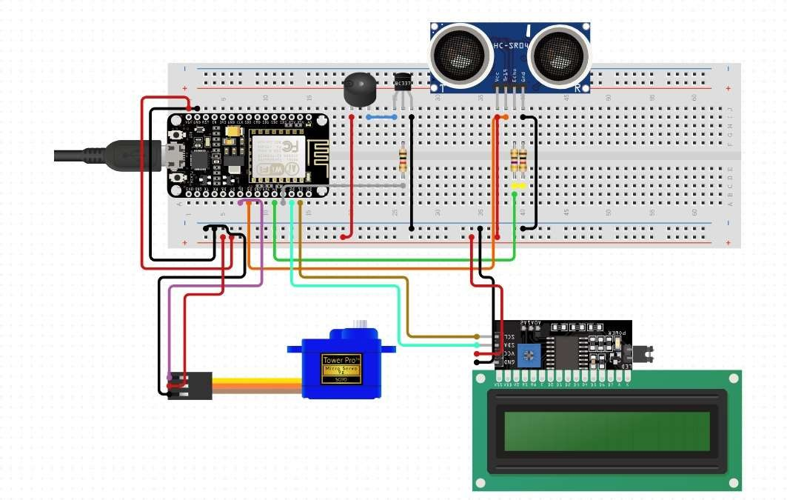
CIRCUIT DIAGRAM
(water level)
Fig.4

Slide 20
RESULTS
The result of the water level indicator in a dam using an ultrasonic sensor, ESP8266 controller, and actuator-based gate opening shows successful automation and safety in water management. The ultrasonic sensor accurately measured the rising water level, and the ESP8266 processed this data to compare with predefined thresholds. When the water crossed the danger level, the actuators were activated to open the gates automatically, allowing controlled release of excess water. The system responded quickly, preventing overflow and potential flooding. Additionally, IoT connectivity enabled real-time monitoring and alerts, ensuring reliability, reducing manual effort, and improving overall dam management efficiency.

Slide 21
PARAMETERS(WATER LEVEL)
WATER LEVEL/DISTANCE | OPERATIONS
SERVO 1 15 TO 10 CM | GATE 1 OPEN
SERVO 2 10 TO 5 CM | GATE 1and 2 OPEN
SERVO 3 5TO 1 CM | GATE 1,2 and 3 OPEN

Slide 22
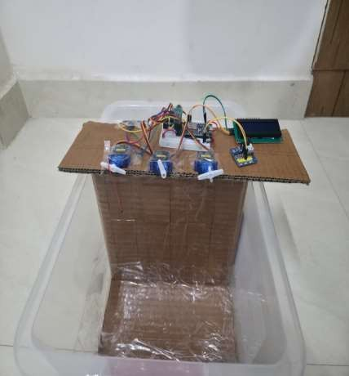
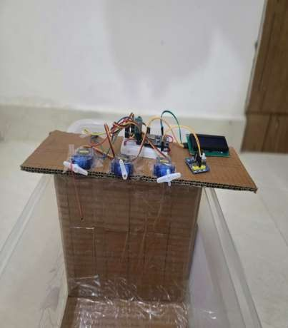
Fig.5

Slide 23
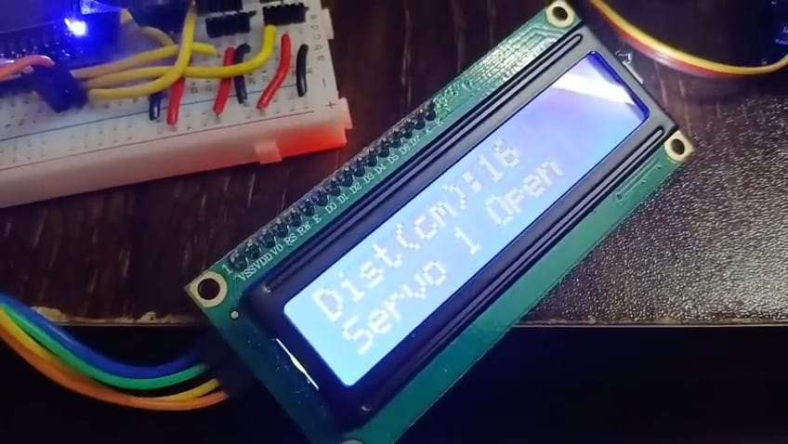
Fig.6

Slide 24
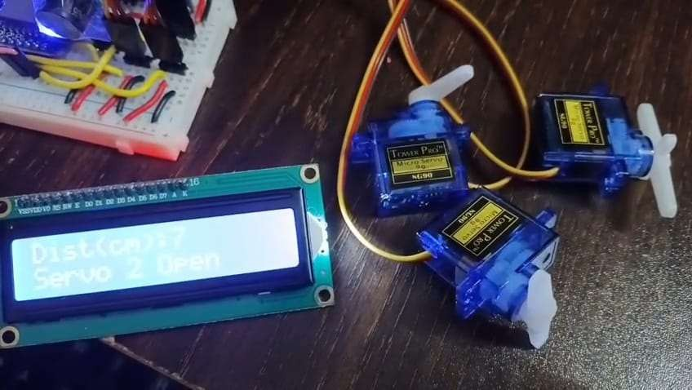
Fig.7

Slide 25
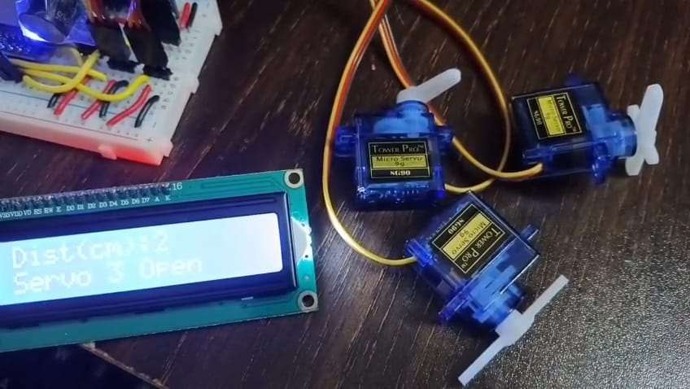
Fig.8

Slide 26
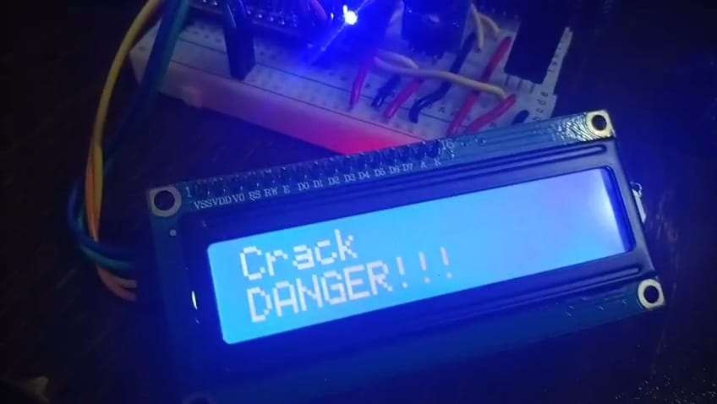
CRACK DETECTION
Fig.9

Slide 27
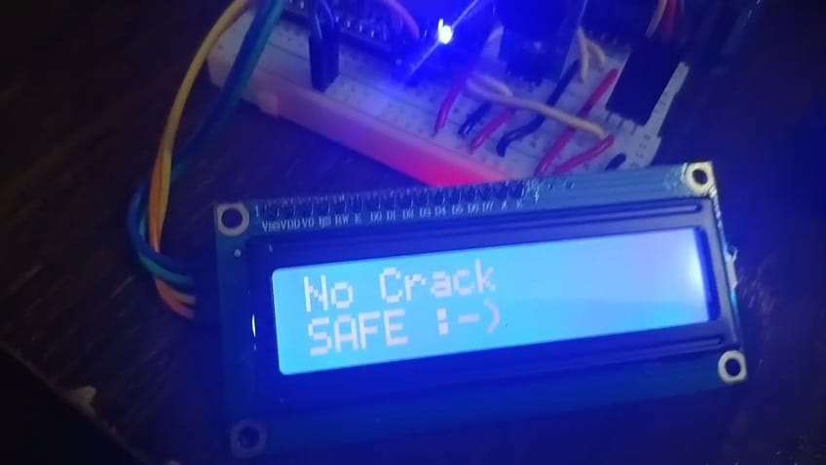
Fig.10

Slide 28
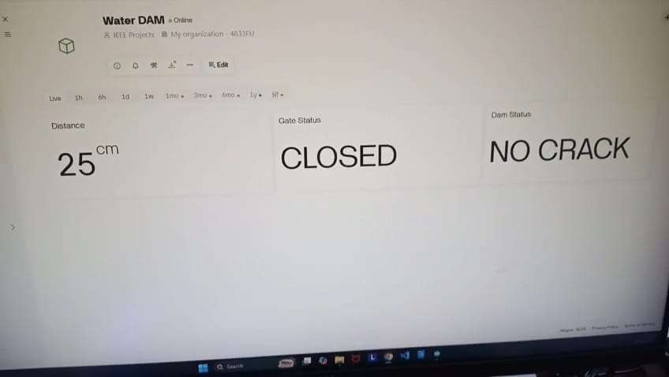
Fig.11

Slide 29
FUTURE SCOPE
Future dam monitoring will use IoT sensors and wireless networks for real-time crack detection and water level monitoring from remote locations
AI and machine learning will improve accuracy by detecting cracks early and predicting possible structural problems, with drones supporting detailed inspections.
Predictive systems using weather and past data will improve dam safety and help manage water resources effectively under changing climate conditions.

Slide 30
Advantages
Ensuring safety by preventing failure
optimizing water management for resources
providing early flood warnings
reducing maintenance costs through proactive repair
extending the overall operational lifespan of the structure.

Slide 31
Disadvantages
Complexity and data overload
Reduced accuracy and reliability due to sensor challenges in harsh
environments
Periodic and disruptive sensor replacement due to finite lifespan.

Slide 32
Conclusion
Integrating crack detection and water level monitoring is essential for dam safety as it helps prevent failures, floods, and damage to critical infrastructure. Although these systems involve high costs and technical challenges in harsh environments, they provide early warnings and improve water resource management. Overall, protecting human life and ensuring safe and responsible water management makes these advanced monitoring systems absolutely necessary.

Slide 33
REFERENCES
Y. Xu, T. Bao, M. Yuan, and S. Zhang, "A Reservoir Dam Monitoring Technology Integrating Improved ABC Algorithm and SVM Algorithm," Water, vol. 17, no. 302, pp. 1- 16, Jan. 2025.
A. Conde, M. Á. Toledo, and E. Salete, "Impact of Arch Dam Cracking on Monitoring Data," Applied Sciences, vol. 15, no. 1096, pp. 1-20, Jan. 2025.
D. Chen, B. Huang, and F. Kang, "A Review of Detection Technologies for Underwater Cracks on Concrete Dam Surfaces," Applied Sciences, vol. 13, no. 3564, pp. 1-17, Mar. 2023.
J. Li, X. Lu, P. Zhang, and Q. Li, "Intelligent Detection Method for Concrete Dam Surface Cracks Based on Two-Stage Transfer Learning," Water, vol. 15, no. 2082, pp. 1-21, May 2023.
D. Park and H. You, "A Digital Twin Dam and Watershed Management Platform," Water,
vol. 15, no. 2106, pp. 1–19, Jun. 2023
S. Song, Q. Zhou, T. Zhang, and Y. Hu, "Automatic Concrete Dam Deformation Prediction
Model Based on TPE-STL-LSTM," Water, vol. 15, no. 2090, pp. 1–18, May 2023.
Dept. of ECE 2025-26
33

Slide 34

GANTT CHART(Phase 1)
 | February | March | April | May
Selection of Topic
Literature Survey
Block diagram
PPT and Report |  | Dept. of ECE | 2025-26
34

Slide 35

GANTT CHART(Phase 2)
 | August | September | October | November
60% of Implementation result and report
80% of Implementatin result and report
100% of Implementation and result
PPT and Report |  | Dept. of ECE | 2025-26
35

Slide 36
SDG’s
Based on the project's focus on crack detection and water level indication in
dams, here are the most relevant Sustainable Development Goals (SDGs)
SDG 6: Clean Water and Sanitation - This goal is directly related to the project's focus on water level monitoring in dams, which is crucial for managing water resources and ensuring access to clean water.
SDG 9: Industry, Innovation, and Infrastructure - The project involves developing and implementing technology for monitoring dam safety, which falls under the development of resilient infrastructure
SDG 11: Sustainable Cities and Communities - Dams play a vital role in community safety and well-being by preventing floods and ensuring water availability. The project contributes to this goal by enhancing dam safety through crack detection and water level monitoring.
SDG 13: Climate Action- Dams are important for water storage and can play a role in climate change adaptation. Monitoring their safety and efficiency is essential in the context of climate change and its impacts on water resources.
Dept. of ECE 2025-26
36

Slide 37
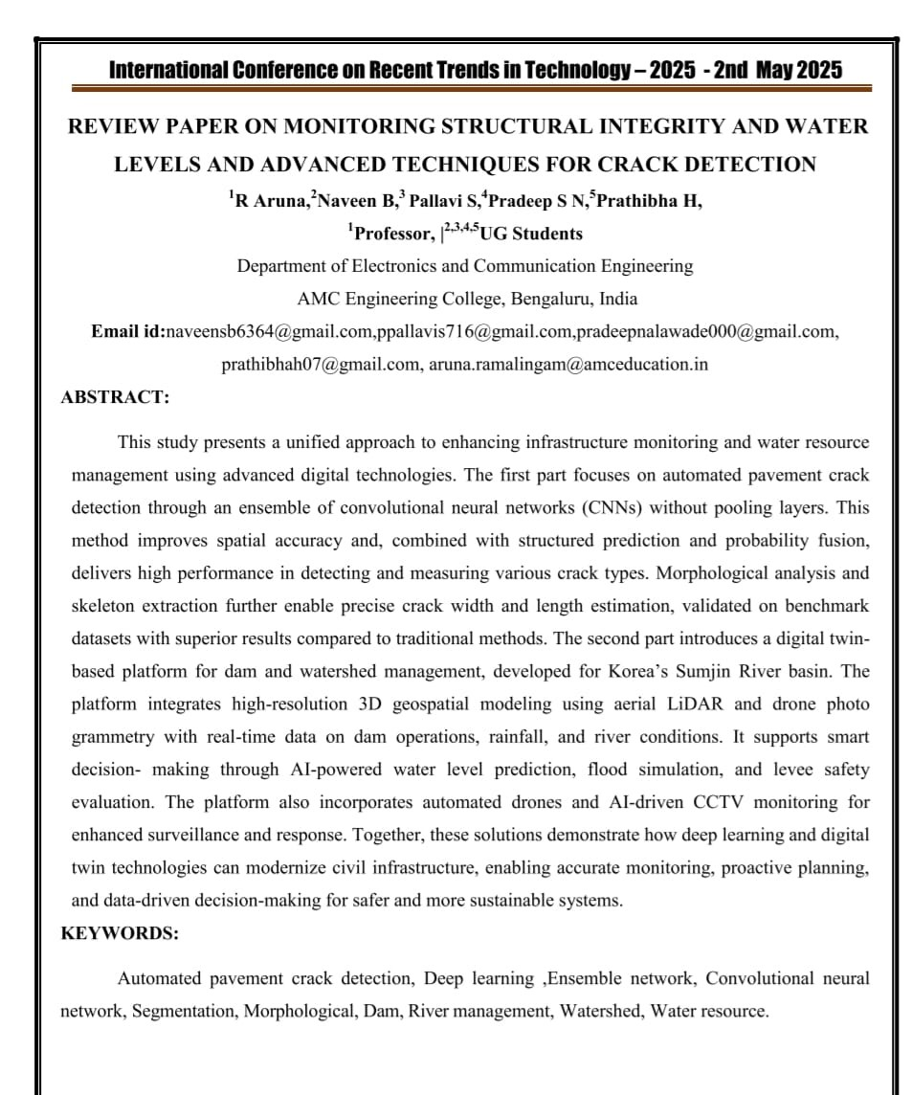

Slide 38
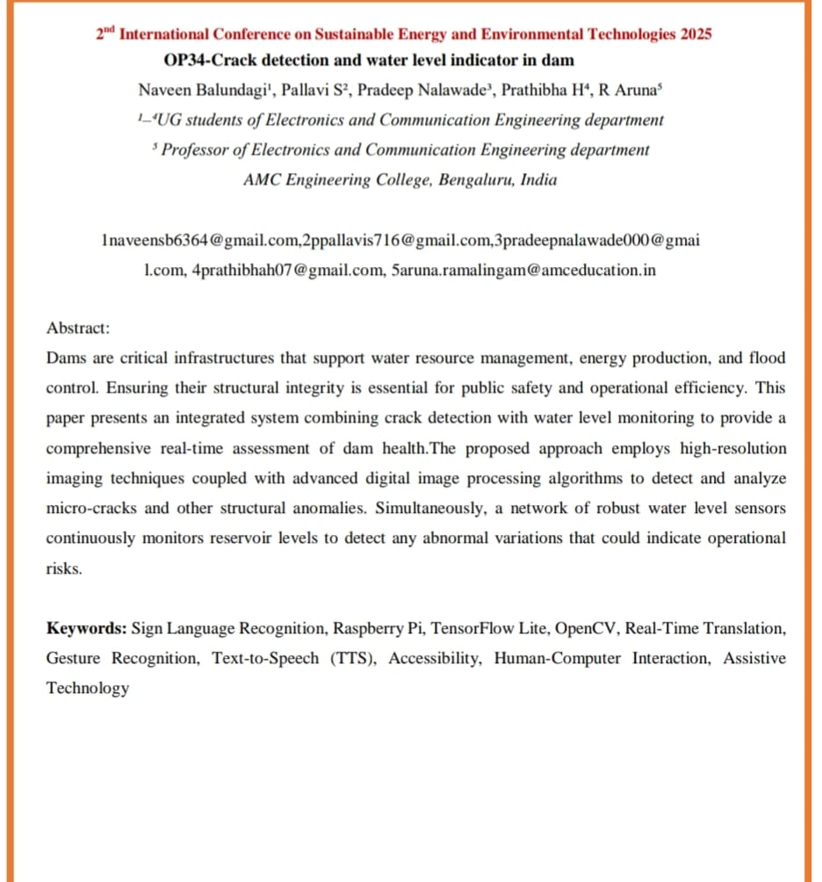

Slide 39
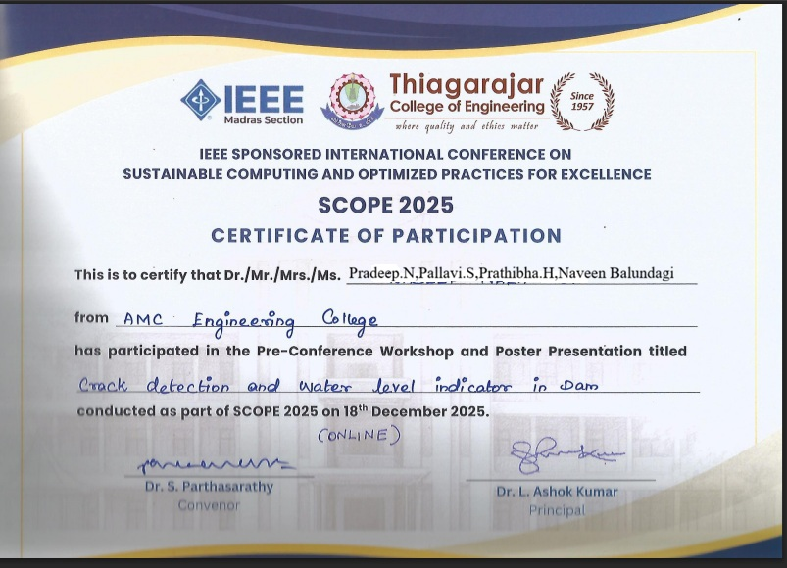

Slide 40
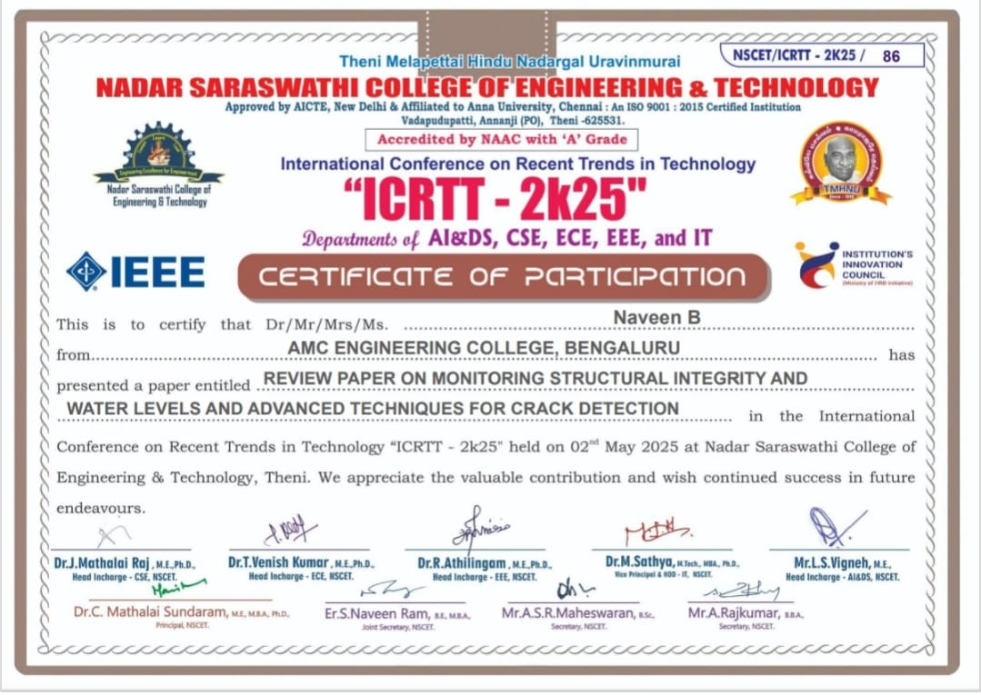

Slide 41


Slide 42
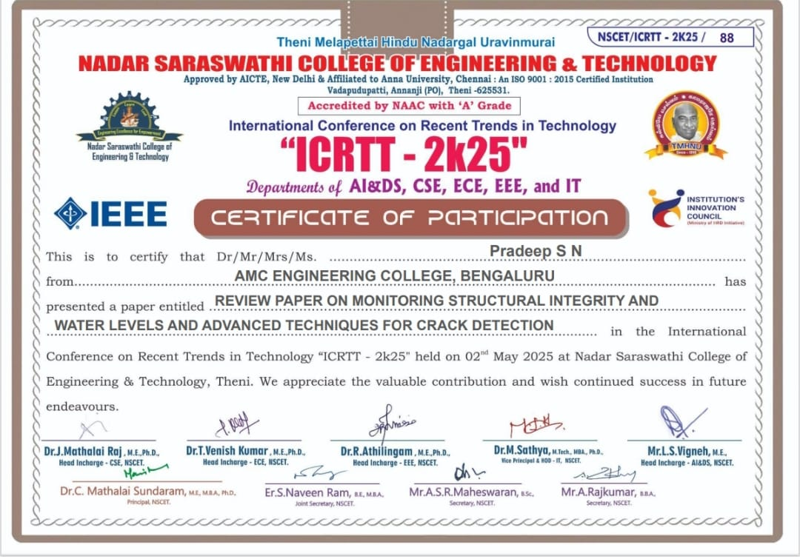

Slide 43
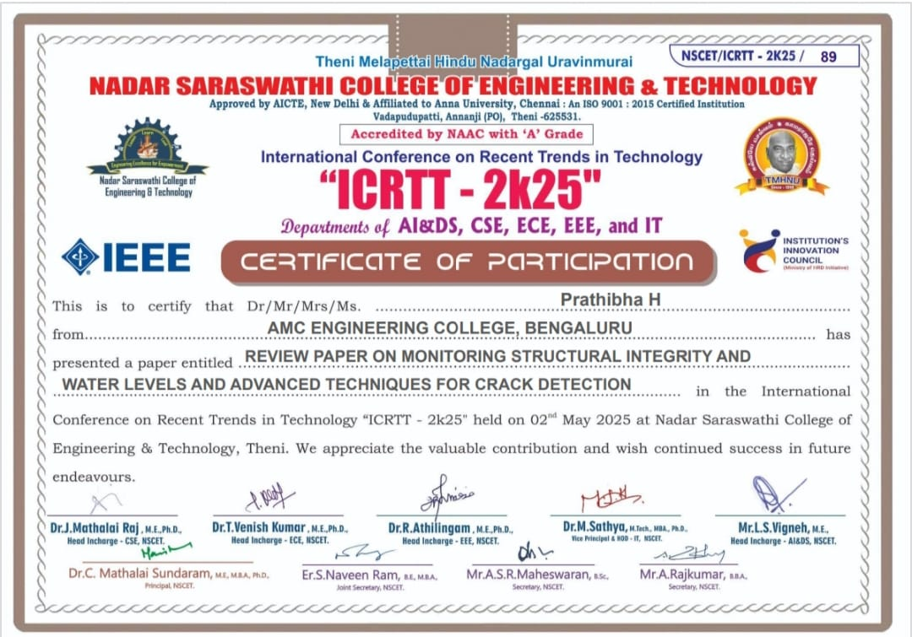

Slide 44
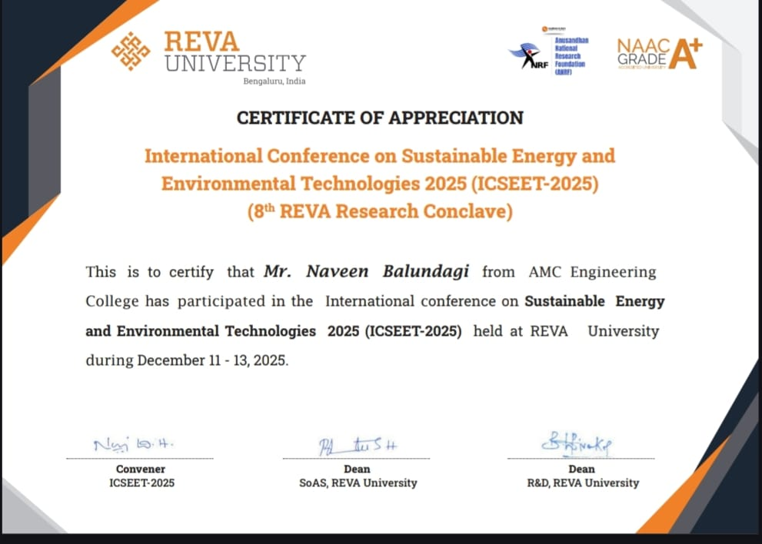

Slide 45
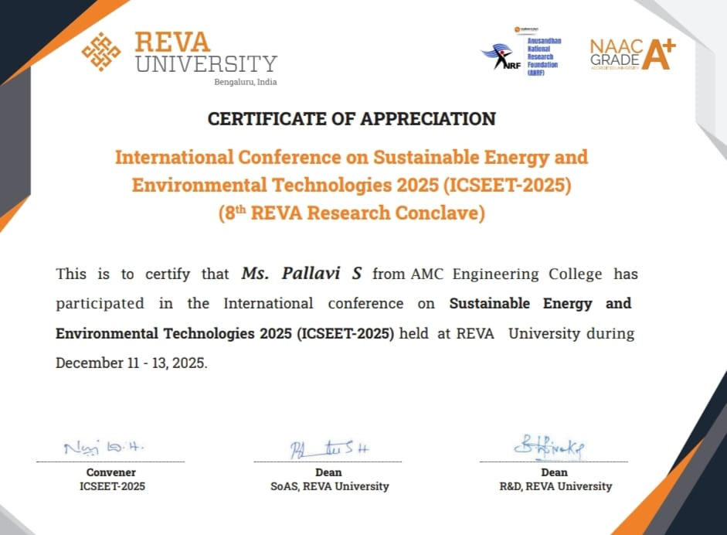

Slide 46
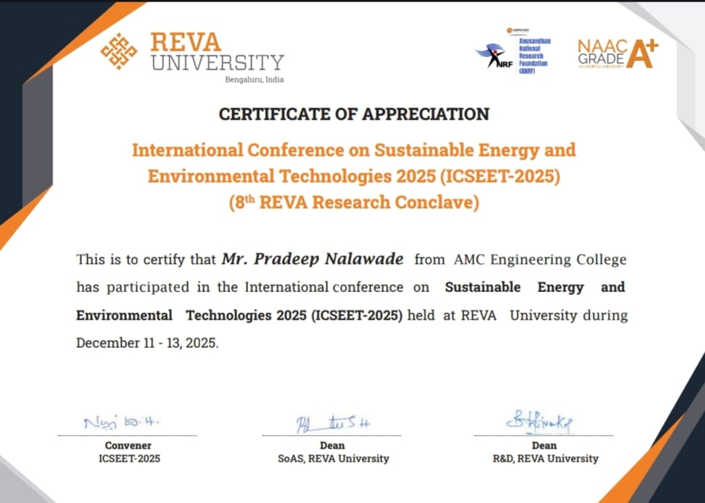

Slide 47
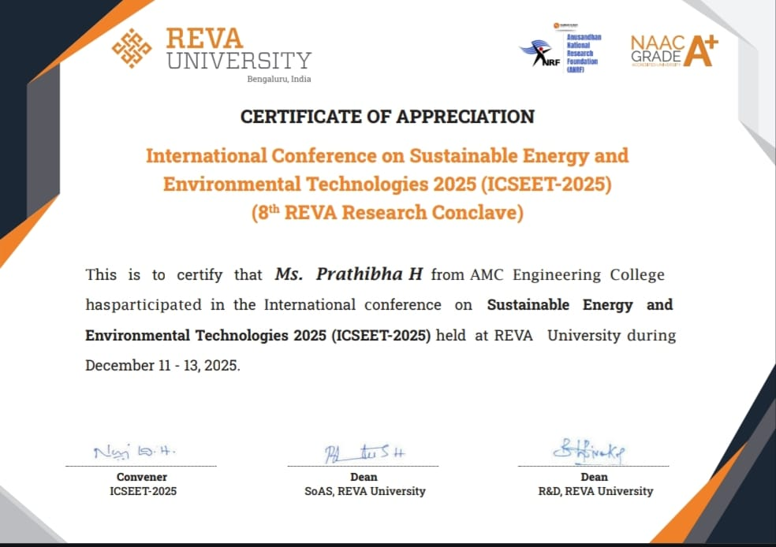

Slide 48
THANK YOU
37

